Slide 1
Project 10K
Annual financial report and financial statements analysis using different machine learning techniques
Team 10K: Thomas Mitrevski, Paul Gill, Yvette Ly, Racim Badsi

Slide 2
Story:
Our client wants to know if he should focus on the financials or the sentiment of the reports or both?
Hypothesis (Revenue Predictions on SEC Filings):
Is it possible, using sentiment analysis, to predict revenue increases or decreases of certain stocks using a company’s financial reports from the last 10 years?
OR is a Time Series Analysis of financial statements (balance sheets, income statements) a better predictor?
PROPOSAL:
Through sentiment analysis, investors can quickly understand if the tone of annual (10K) and quarterly (10Q) are positive, negative, or litigious etc. The overall sentiment expressed in these reports can then be used to help investors decide if they should invest in a company.
On the other hand, many would argue that nothing beats the numbers, and many investors would prefer to look at a company’s financials before they invest.

Slide 3
Motivation and Summary for Sentiment Analysis
We want to look at the contents of 10-K and 10-Q statements to determine if the sentiment contained in the text will predict a shift in the prices during the week after the statement is released.
If we can show that the sentiment contained in in a 10-K statement affects the price in a fashion different from the normal price movement, we may be able to take advantage of that in an algorithmic trading signal in the future.

Slide 4
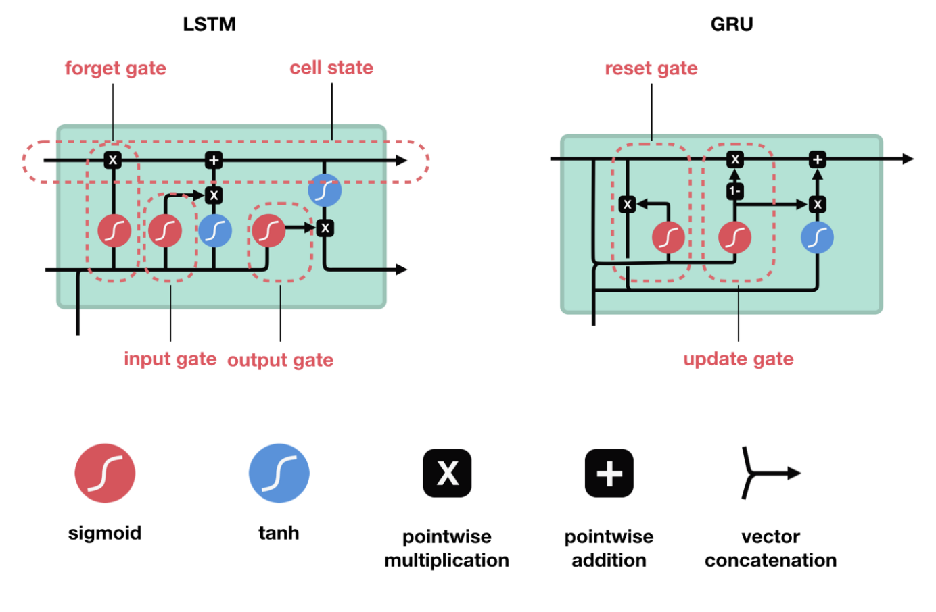
Sentiment Analysis Model Summary
We used a RNN in order to generate the signals that originated from the 10-K and 10-Q statements submitted to the SEC
We generated a fairly deep model based off of a research paper created by Sander Blomme in 2020
This paper found that the structure of the model succeeded best when using an embedding layer to create the initial vectors, as well as a bidirectional GRU instead of LSTM in order to develop a more comprehensive understanding of text and faster performance.
Several Batch Normalization and Dropout layers were also included in order to increase performance and prevent overfitting

Slide 5
Data Cleanup
SEC filings were retrieved from the EDGAR site over a period of multiple days
SEC filings were cleaned using regular expressions and a technique noted by Jörg Hering in 2016
From there, the text from sections 1, 1a, 7, and 7a were extracted as these contain the most relevant business text. These sections deal with a description of the company’s business, any business risk factors, management’s discussion of financial condition, and discussions of Market Risk.
The prices were retrieved for the period of 3 months before and 1 month after using the Yahoo Finance API
Fetching and the cleanup of data was way more difficult and took much longer than expected
Once the SEC filings were retrieved and cleaned, n-grams were created from the texts in order to provide context for the words in the documents
The n-grams were then tokenized in order to pass into the RNN

Slide 6
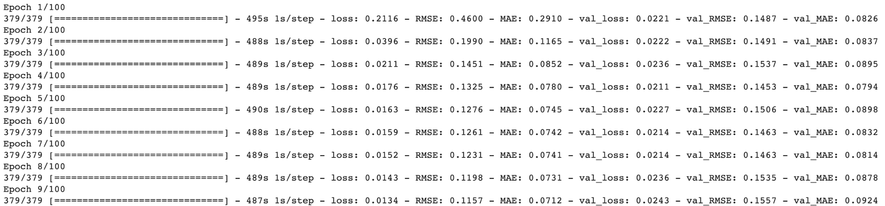
Model Training
The model was trained using the tokens from the SEC filings as well as the corresponding SEC data
The RNN was designed to optimize for a regression was run to evaluate MSE and ran for 9 epochs
Training took approximately 1 hour on a CoLab GPU. Cloud computing needed to be used and data size needed to be reduced as original average epoch time on a Mac was 8 hours.

Slide 7
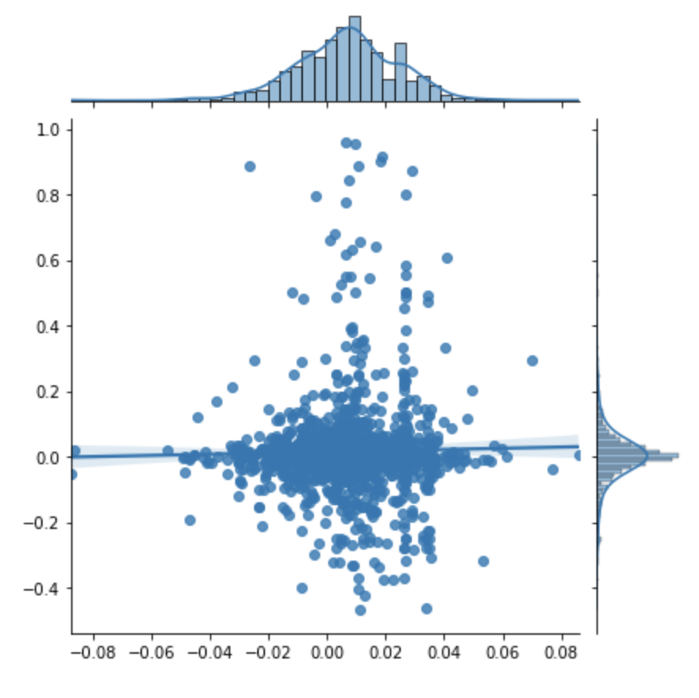
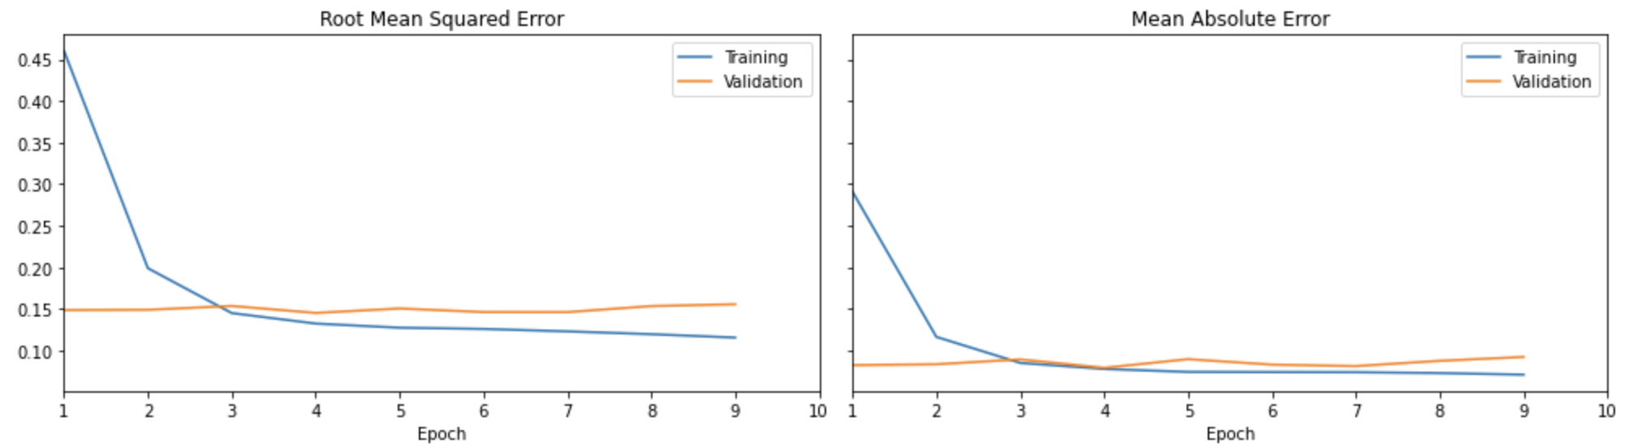
Model Evaluation and Discussion
We found a RMSE of .1557
We also calculated a spearman correlation and this showed a 77% p-value that predicted score was influencing the actual price difference
This is not sufficient because this value shows there is a high likelihood that the price change of a stock was influenced by things other than the sentiment contained in the 10-K or 10-Q release.

Slide 8
Postmortem
Extreme difficulty retrieving and cleaning the data. The only reason we had enough time is because we started the project early.
The text we received from the SEC site was UNICODE encoded, and a lot of extra characters had to be dropped in order to better process the data
The model took an extremely long amount of time to train, and it was very difficult to run multiple iterations.
We made arbitrary decision to truncate length of sentences and how many words we could look back on in order to speed up training, and these could probably be optimized.
We could also change the size of the embeddings and add more data in order to further optimize the model.

Slide 9
Motivation and Summary for Time Series Analysis
We want to look at the contents of 10-K and 10-Q statements to determine if the contents of the Income Statement, Balance Sheet and Statement of Cash Flows will predict a shift in the prices on the dates the statements are published.
If we can show that the Key Performance Indicators (KPIs) contained in the Financial Statements affect the price in a fashion different from the normal price movement, we may be able to take advantage of that in an algorithmic trading signal in the future.

Slide 10

ROADBLOCK
Because raw data from the 10-K and 10-Q SEC filings is extremely robust, we chose to retrieve data from SimFin
By using SimFin Python API, we were able to download and use not just the raw financial data but the KPIs of publicly traded companies as well. For this particular machine learning model, we performed a time series analysis from the information derived from the Income Statement, Balance Sheet and Statement of Cash Flows.

Slide 11
Time Series Analysis Model Summary
We downloaded datasets to include the Income Statements, Balance Sheets, Cash-Flow Statements, and Share Prices of companies traded in the US. Then used quarterly data for financial reports, and daily data for share-price.
With a SimFin+ subscription, we were able to load the derived figures & ratios dataset. This dataset contains pre-calculated fundamental ratios which we then used as our signals.
We used the SimFin tutorial presented by Hvass Laboratories as a guide for our models.
Since some of the signals have a lot of missing data which causes problems in the statistical analysis, we removed all signals that have more than 25% missing data. Examples include, R&D/Revenue, Inventory Turnover, etc.
From the remaining data, we used the mean-log returns of 1-3 year periods in the dataset. This is because data from the financial statements will be exactly the same for 3 months at a time, it cannot be used to predict short-term stock-returns.
We removed outliers by “Winsorization” of the data.
We looked at the linear correlation between the signals and stock-returns, to roughly assess which signals might be the best predictors for stock-returns.
We split the dataset according to stock-tickers, so a ticker belongs to either the training- or test-set, but not both. We used 80% of all the tickers in the training-set, and 20% in the test-set.

Slide 12
Signals
Financial Signals - Current Ratio, Debt Ratio, Net Profit Margin, Return on Assets, etc.
Growth Signals - Earnings Growth, FCF Growth, Sales Growth, etc.
Valuation Signals - P/E, P/ Sales, P/Cash, etc.

Slide 13
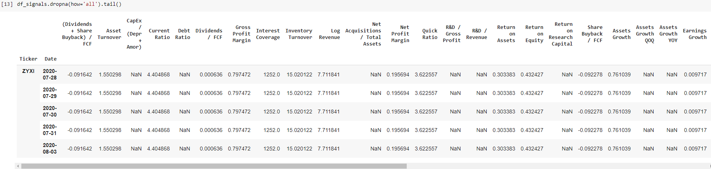
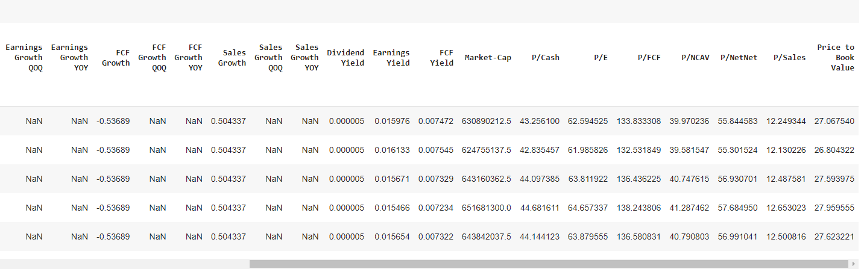
Combined Signals Dataframe

Slide 14
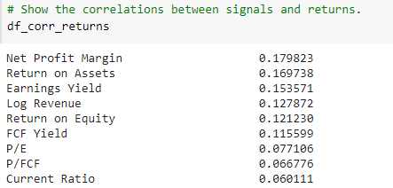
Correlation: Signals vs Returns

Slide 15
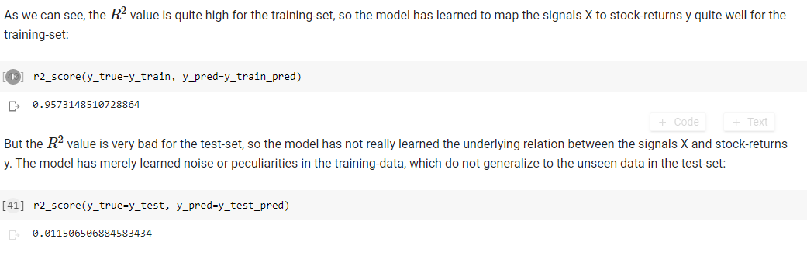
REGRESSION MODEL & RESULTS

Slide 16
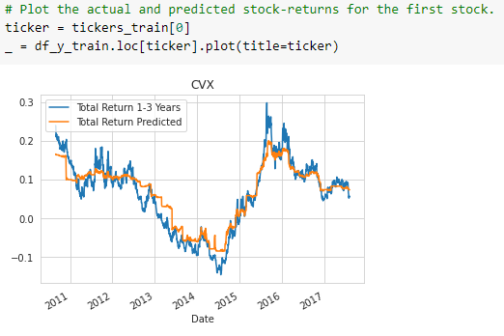
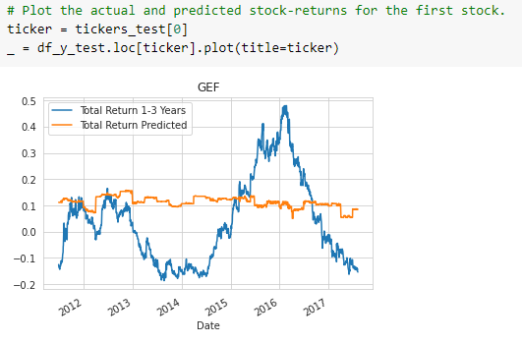
Actual and Predicted stock-returns plots for CVX and GEF
Train set vs Test Set

Slide 17
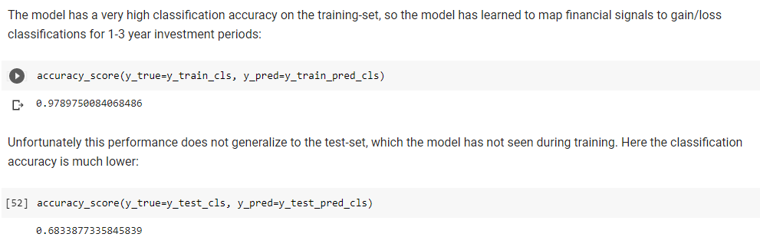
CLASSIFICATION
Confusion MTRX
Classification report
Classification Results

Slide 18
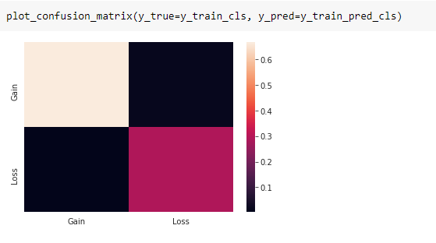
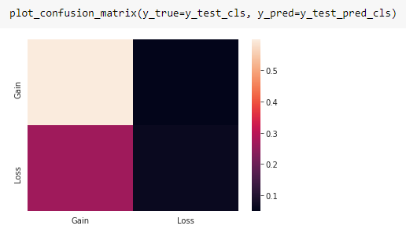
Confusion Matrix
Train Set vs Test Set

Slide 19
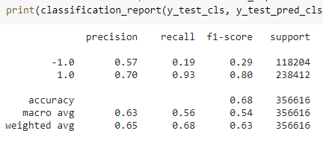
Classification Report

Slide 20
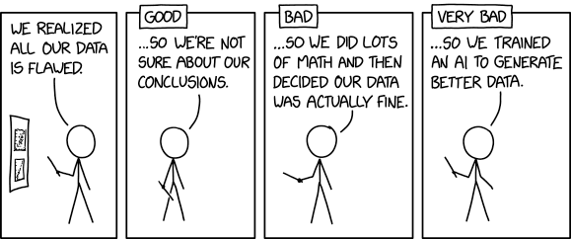
CONCLUSIONS

